Slide 1
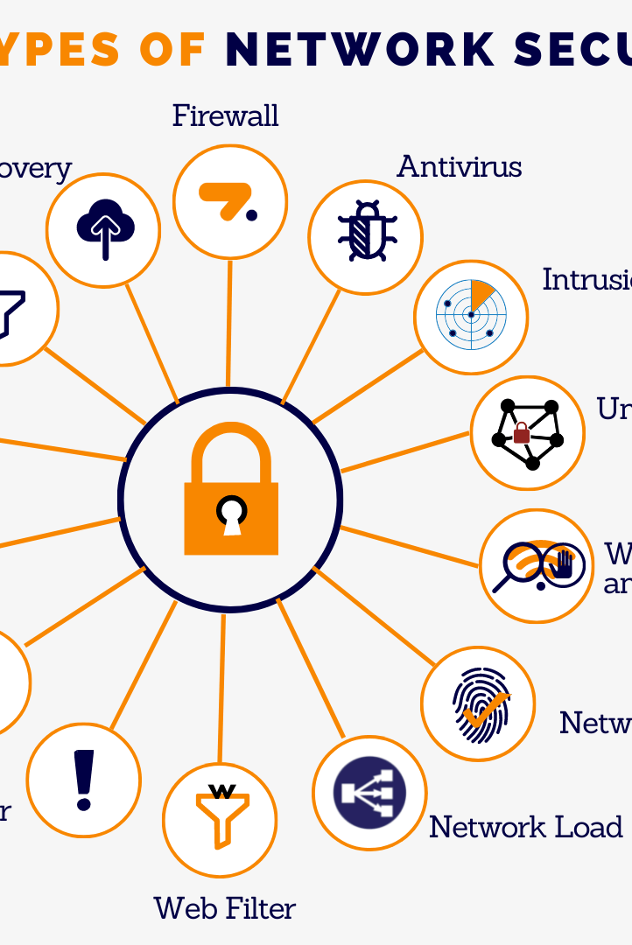
Automated IT-OT Network Device
Classification
As networks become more complex, it's increasingly important to distinguish between Information Technology (IT) and Operational Technology (OT) devices for effective cybersecurity management. Manual classification can be time-consuming and error-prone, so we propose an algorithmic approach for automated IT/OT classification.

Slide 2

The Convergence of IT and OT
1
IT
Information Technology
2
OT
Operational Technology
3
Challenge
The convergence of IT and OT has made the classification of network devices more challenging than ever before, due to the diversity of communication protocols and port numbers inherent in each domain.

Slide 3
Related Work
Features for OT and IT Systems
Databases
Various databases were analyzed to identify and classify IT and OT devices.
Function Codes
We also reviewed the function codes used by IT and OT devices to establish a comprehensive list of features.
Banner Grabbing
MAC address mechanisms were used for banner grabbing in IT systems, while function codes were used to grab banners in OT systems.
Literature Review & Mac Algos
Conducted multiple literature reviews to elevate our understanding of the topic.

Slide 4

The Proposed Algorithm
Our algorithm performs data preprocessing, payload tokenization, feature scoring, and machine learning. By calculating an IT and OT score for each packet using packet source port numbers, protocol names, and payload content, we enhance the accuracy of our classification. Our algorithm also identifies email, webpage, and hexadecimal patterns in payload data to further improve classification precision.

Slide 5

Challenges and Limitations
1 2
Data Quality Dependence
The accuracy of the classification heavily relies on the quality and quantity of training data available.
Pattern Dependence
The proposed scoring system heavily depends on predefined patterns, keywords, and regular expressions.
3
New Communication Patterns
New communication patterns can lead to false positives or negatives affecting the classification accuracy.

Slide 6
Methodology
Data Collection and Preparation
Identify IT and OT network devices' data sources and create datasets containing port numbers and protocol names.
Tokenization and Word2Vec Embedding
Convert payload data into lowercase and remove non-alphanumeric characters, utilizing the nltk library to tokenize the payload and to create Word2Vec models.
Scoring System
Check for source port matches and examine payload data for email or webpage-related patterns and the existence of hexadecimal patterns.
Payload Content Analysis
Analyze payload data to identify the presence of port matching, protocol matching, payload token matching, email/webpage detection, and hexadecimal detection for both IT and OT devices.

Slide 7
Classification and Model Evaluation
1 2 3
4
Classification
Classify each packet as IT or OT device based on the higher cumulative score obtained.
Validation
Cross-reference the assigned IT/OT label with external sources to ensure data integrity.
Label Encoding
Apply label encoding to convert the categorical IT/OT labels into numerical values suitable for machine learning.
Random Forest Classifier
Employ the Random Forest Classifier algorithm to train a machine learning model.

Slide 8
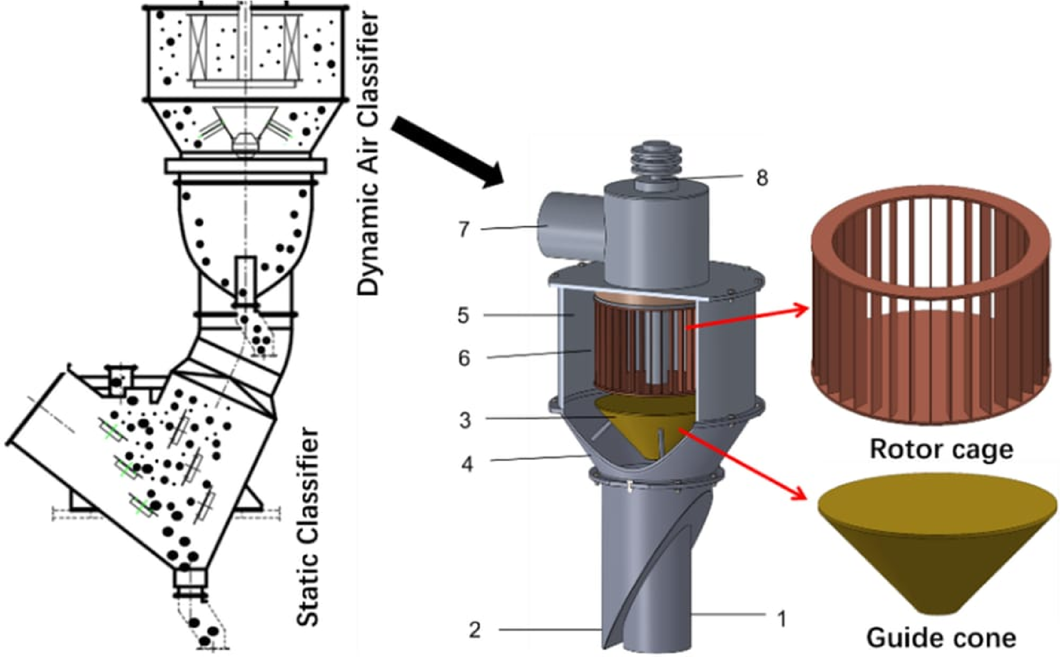

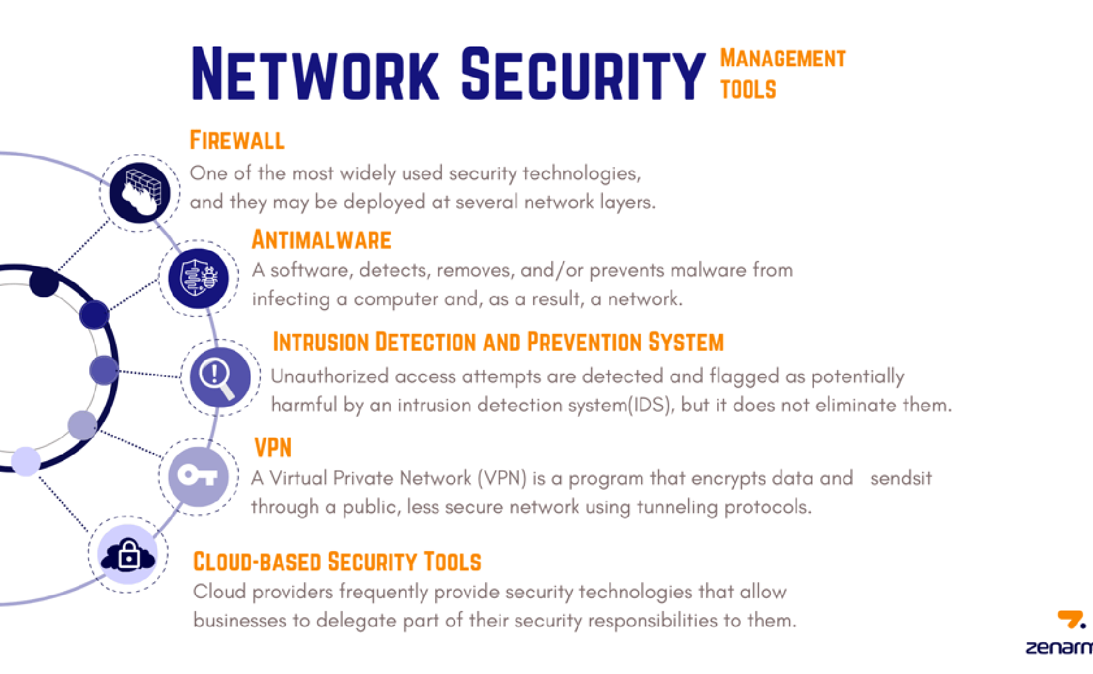
Results and Discussion
Classification Rate
Our algorithm achieved a classification rate of 99.97% in distinguishing between IT and OT network devices.
Key Attributes
Our algorithm harnessed port numbers, protocol names, payload tokens, and content patterns to differentiate between the two categories.
Potential Benefits
The achieved accuracy can significantly contribute to enhancing network security and operational efficiency.

Slide 9
Future Work
Algorithm's Adaptability
Refining the algorithm's adaptability to dynamically evolving network landscapes presents a challenging yet crucial avenue.
Advanced Machine Learning Algorithms
Exploring more advanced machine learning algorithms and devising strategies to accommodate evolving communication patterns.
Deep Learning Networks
Integrating advanced machine learning paradigms like deep learning networks could unravel latent insights within complex packet data.

Slide 10

Conclusion
Our proposed algorithm demonstrated exceptional accuracy, showcasing its potential to effectively differentiate between IT and OT devices with a certain degree of accuracy. The findings of this research contribute to the ongoing discourse on automated device classification and pave the way for enhanced security, management, and optimization of heterogeneous networks in the Industry 4.0 era.

